Slide 1
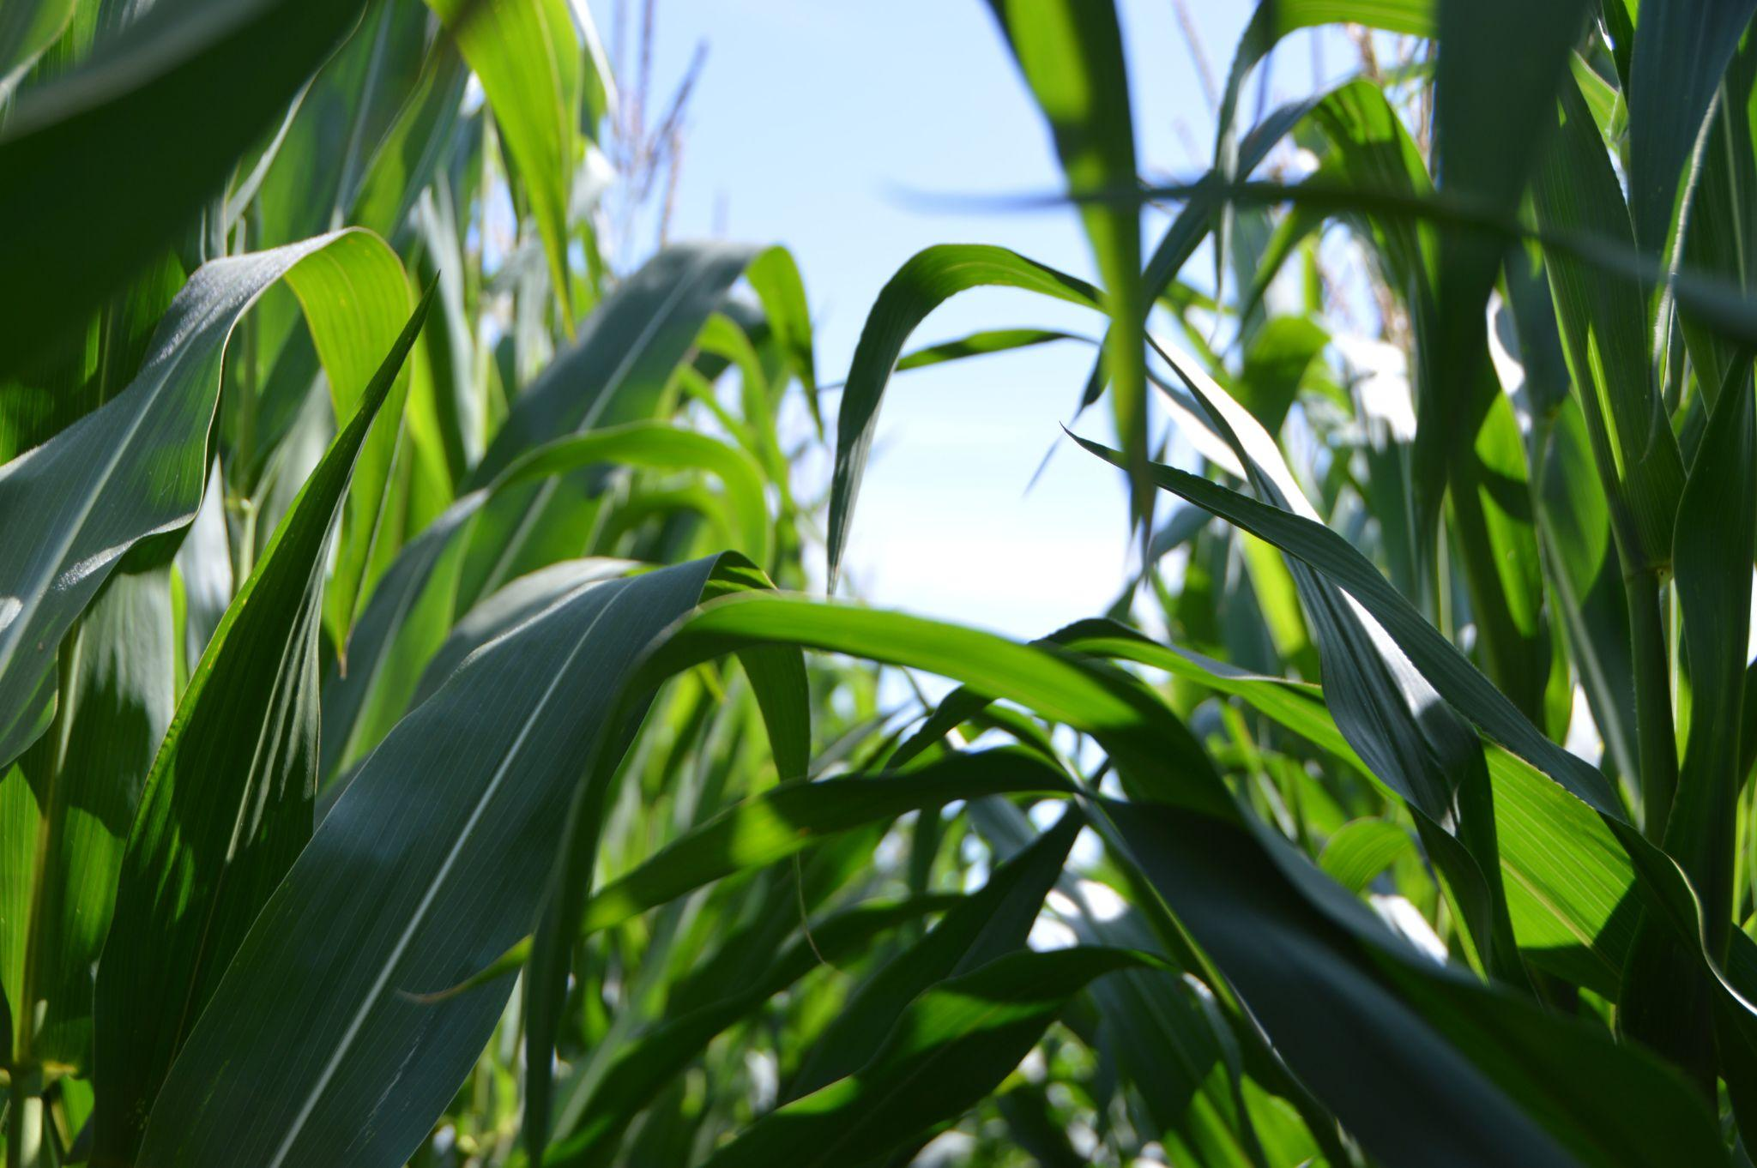

DEPARTMENT OF COMPUTER ENGINEERING
Agricultural Recommendation System using Machine Learning
Arya Totey 19102070
Avishkar Dalvi 20202002
Radha Rakshe 19102067
Riddhi Narkar 19102003
Under the Guidance of: Prof. Deepak Khachane

Slide 2
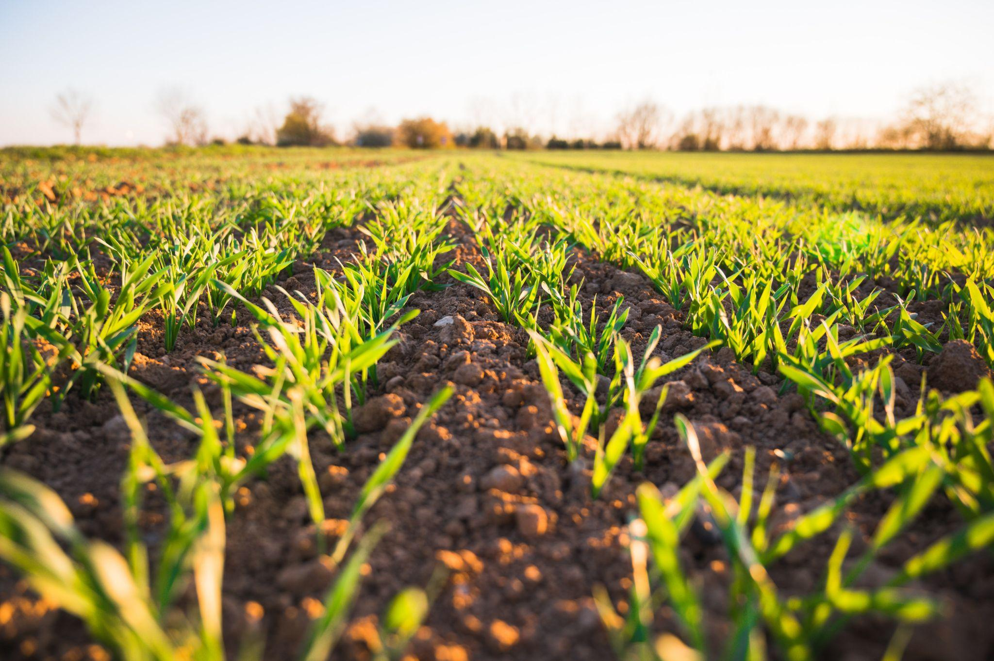
Introduction
As per the census in 2011; in India, approximately 118 million people are farmers and 144 billion people are laborers working in an agricultural field. Total Indian population of India in 2011 was nearly about 121 crore and out of which nearly about 2630 lakh people are farmers. With the production of agriculture activity of $375.61 billion, India is 2nd larger producer of agriculture products .India accounts for 7.39 percent of total global agricultural output.
With the vision of providing assistance and guidance to farmers during the crucial decision-making process required at various stages during farming, we propose a solution in the form of three ML models. Under many government schemes, farmers are able to get their land tested for nutrients. A farmer has all the lab results, but is not able to turn those results into actions and implementation. This work bridges that gap.

Slide 3
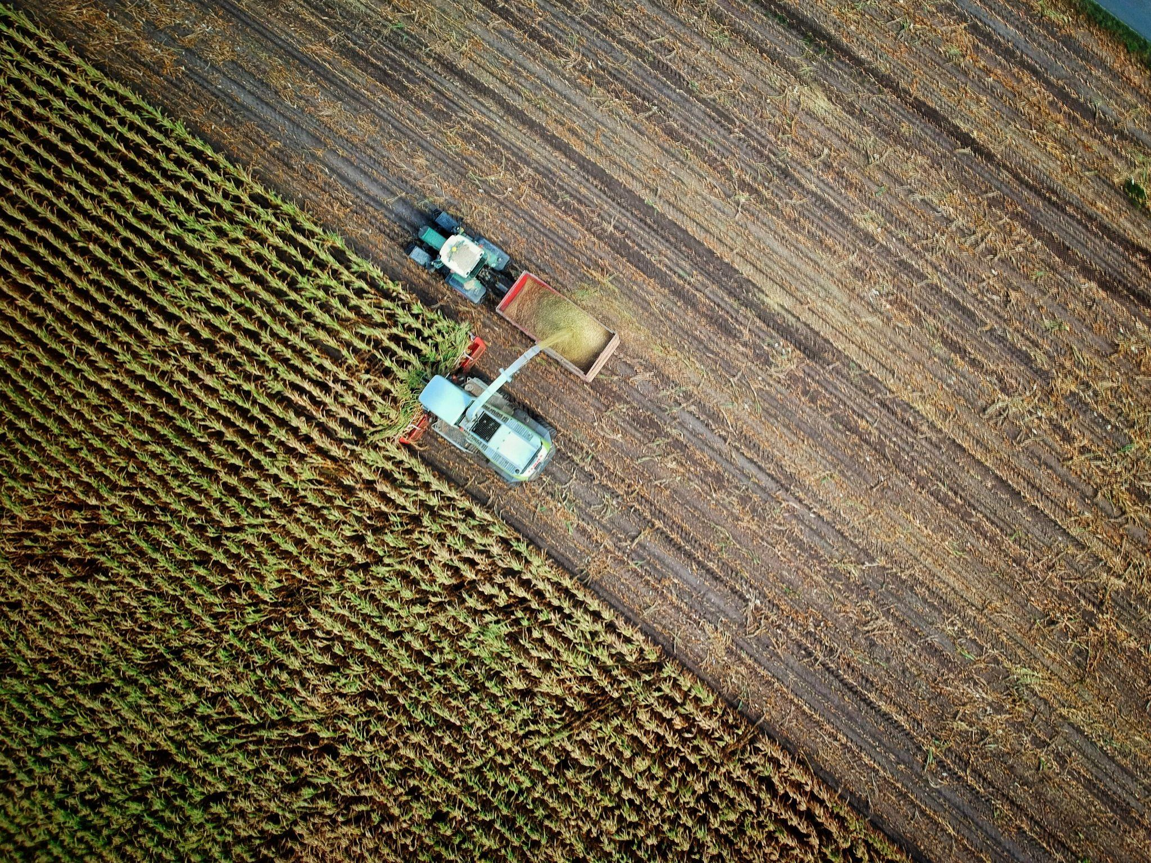
Problem Statement
To implement a system for farmers with features of crop recommendation, fertilizer recommendation, and crop leaf disease identification. As easy as it might be to be a city dweller, we cannot ignore to the plights of our farmers. India has a primary sector economy, that means that majority of our population is involved in agriculturally based activities and are dependent on crops related business for their livelihood. India, no doubt is an agrarian society, and we often tend to ignore this fact. Multiple unsustainable technologies took a huge toll on our Earth in the recent past decades giving rise to global warming and climate as worldwide crisis. This hurts the farmer the most, as they are often lacking proper guidance and resources to solve their problems. Lal Bahadur Shastri once said, “Jai Jawan Jai Kisaan”, which believed in uplifting the role of a farmer. This project is aimed at assisting the farmer by deploying a crop recommendation system, a fertilizer recommendation system, and a crop disease identification system with cures. All these would be implemented as three different ML models and integrated into a single webpage for easier and convenient access.
Notes:
As easy as it might be to be a city dweller, we cannot ignore to the plights of our farmers. India has a primary sector economy, that means that majority of our population is involved in agricultural based activities and are dependent on crops related business for their livelihood. India, no doubt is an agrarian society, and we often tend to ignore this fact.
Multiple unsustainable technologies took a huge toll on our Earth in the recent past decades giving rise to global warming and climate as worldwide crisis. This hurts the farmer the most, as they are often lacking proper guidance and resources to solve their problems. Lal Bahadur Shastri once said, “Jai Jawan Jai Kisaan”, which believed in uplifting the role of a farmer. We tried to combat a few issues farmers face by providing a solution in the form of Farmerable.
Farmerable is a website aimed at assisting the farmer. It consists of a crop recommendation system, a fertilizer recommendation system, and a crop disease identification system. All these would be implemented as ML models and integrated into a single webpage for easier and convenient access.

Slide 4
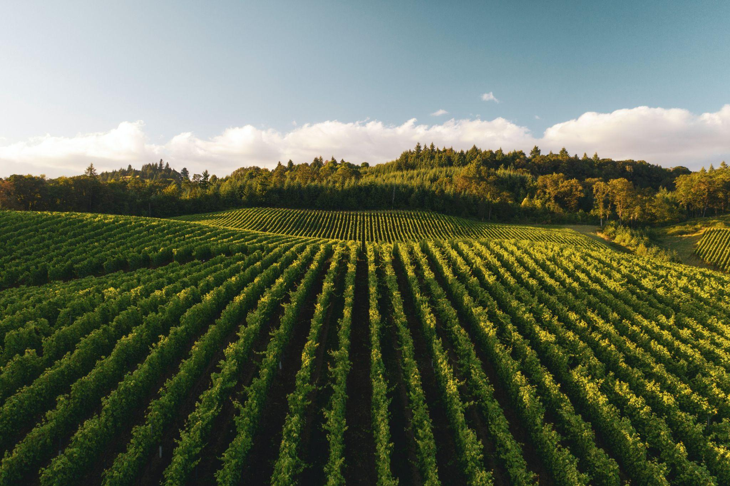
Literature Survey
Title of the research paper | Year published | Authors | Abstract
﻿Machine Learning based Crop Recommendation System for Local Farmers of Pakistan A Research Gate Preprint Online Publication | 2021 | ﻿Sayed Mazhar Ali, Bhagwan Das, Dileep Kumar Department of Electronic Engineering, Quaid-e-Awam University of Engineering, Science and Technology, Nawabshah, Sindh, Pakistan. | ﻿In Pakistan, the most part of the land is used for agriculture cultivation to meet the desires of nearby people and export want as properly. Crop cultivation anywhere in the world depends on the climate so called seasons and soil properties, however, the enhancing the production of crops depend on various factors like mainly on temperature. In order to address the issue of increasing crop production for Pakistan, a crop recommendation system is proposed in this work. In this work, idea of ideal harvest prior to planting it, it would be of extraordinary assistance to the farmers and others required to settle on fitting choices on upgrading the creation of yields for neighborhood utilization needs and may prompt the capacity and expanded fare choice for business. Our framework utilized Machine Learning procedures with the end goal that it proposes the appropriate corps dependent on the temperature. This framework subsequently diminishes the monetary misfortunes looked by the farmers brought about by establishing the ominous harvests and furthermore it gives the information on the occasional characterization of yields what harvest is reasonable for which season. It is concluded that proposed algorithm has an average accuracy of 90% on the given dataset. The achieved accuracy is more in comparison to existing work.
﻿﻿Machine Learning Based Crop Recommendation System ﻿International Journal of Advanced Research in Science, Communication and Technology | 2021 | ﻿Dhruv Piyush Parikh, Jugal Jain, Tanishq Gupta, Rishit Hemant Dabhade ﻿Vellore Institute of Technology, VIT Chennai, India | ﻿﻿The three most basic amenities required for the survival of a human being are food, shelter and clothing. In today’s tech-savvy generation, the latter two have witnessed a huge scientific boost. Unfortunately, even today, agriculture is considered as more of a man-power oriented field. Most of the farmers are untutored and have little to no scientific knowledge of farming. So, they have to rely on the hit and trial method to learn from experience which leads to wastage of time and resources. Our system focuses on building a predictive model to recommend the most suitable crops to grow in a particular farm based on various parameters. This can be helpful for the farmers to be more productive and competent without wasting any resources by farming the most competent crops.

Slide 5
Literature Survey
Title of the research paper | Year published | Authors | Abstract
﻿Machine Learning based Recommender Systems for Crop Selection: A Systematic Literature Review A Research Gate Preprint Online Publication | 2022 | ﻿Younes OMMANE, Mohamed Amine RHANBOURI, Hicham CHOUIKH, Mourad JBENE, Ikram CHAIRI Université Mohammed VI Polytechnique | Choosing an appropriate crop for a given farm is a difficult decision including a plethora of variables that influence the final yield. Experts are frequently consulted to assist farmers with CS; but, as this alternative is time consuming and expensive, it is not available to many farms. The use of recommender systems (RSs) in agricultural management has recently brought some captivating and promising results. We propose a systematic literature review (SLR) in this article to find and provide the most relevant and high-quality publications ad- dressing the crop recommendation (CR) question. The core concept of this SLR is inspired from the guidelines of PRISMA 2020.The different CR approaches are discussed, as well as all the most important input features for recommendation, which are determined and classified. We also identified some of the biggest hurdles to using CR in agriculture. Besides, we made an inventory of the most used techniques for CR. Further, we made an inventory of evaluation criteria and evaluation approaches.
﻿Crop Recommendation System ﻿International Journal of Computer Applications (0975 – 8887) Volume 175– No. 22, October 2020 | 2020 | ﻿Pradeepa Bandara, Thilini Weerasooriya, Ruchirawya T.H., W.J.M. Nanayakkara, Dimantha M.A.C, Pabasara M.G.P. Sri Lanka Institute of Information Technology, Sri Lanka | ﻿Recommendation system through integrated models of collecting environmental factors using Arduino microcontrollers, Machine learning techniques such as Naïve Bayes (Multinomial) and Support Vector Machine (SVM), Unsupervised machine learning algorithm such as K-Means Clustering and also Natural Language Processing (Sentiment Analysis) concerned with the Artificial Intelligence to recommend a crop for the selected land with site-specific parameters with high accuracy and efficiency. It has been a major problem to identify what to grow, any man has adequate space in the owner’s land. Not only domestic lands but also for farming lands. Why it has become a problem is that environmental factors such as temperature, water levels, and soil conditions are uncertain as they change from time to time. Due to these problems, this solution of crop recommendation system predicts the user, what crop type would be the most suitable for the selected area by collecting the environmental factors for plant growth and processing them with the trained sub-models of the main of the system.

Slide 6
Literature Survey
Title of the research paper | Year published | Authors | Abstract
﻿Using Deep Learning for Image-Based Plant Disease Detection Frontiers in Plant Science Online Publication | 2019 | ﻿﻿Sharada P. Mohanty, David P. Hughes, and Marcel Salathé ﻿Digital Epidemiology Lab, EPFL, Geneva, Switzerland, School of Life Sciences, EPFL, Lausanne, Switzerland. | ﻿﻿Crop diseases are a major threat to food security, but their rapid identification remains difficult in many parts of the world due to the lack of the necessary infrastructure. The combination of increasing global smartphone penetration and recent advances in computer vision made possible by deep learning has paved the way for smartphone-assisted disease diagnosis. Using a public dataset of 54,306 images of diseased and healthy plant leaves collected under controlled conditions, we train a deep convolutional neural network to identify 14 crop species and 26 diseases (or absence thereof). The trained model achieves an accuracy of 99.35% on a held-out test set, demonstrating the feasibility of this approach. Overall, the approach of training deep learning models on increasingly large and publicly available image datasets presents a clear path toward smartphone-assisted crop disease diagnosis on a massive global scale.

Slide 7
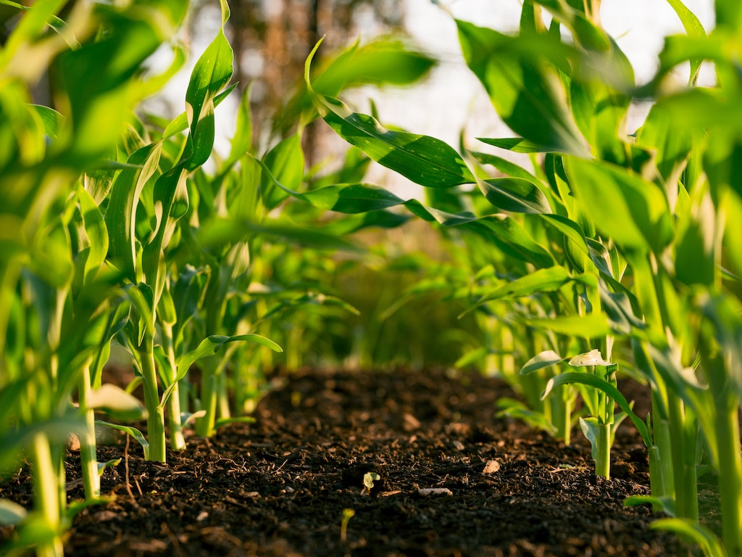
Objective
﻿To provide a single place to access help for crop related problems, the causes, and how to cure them, thus providing a solution-based approach.
To make these services available over the internet in order to maximize reach
To try to make the UI as simple as possible so that a naïve user, whose computer literacy is lower than average, too, can easily navigate

Slide 8
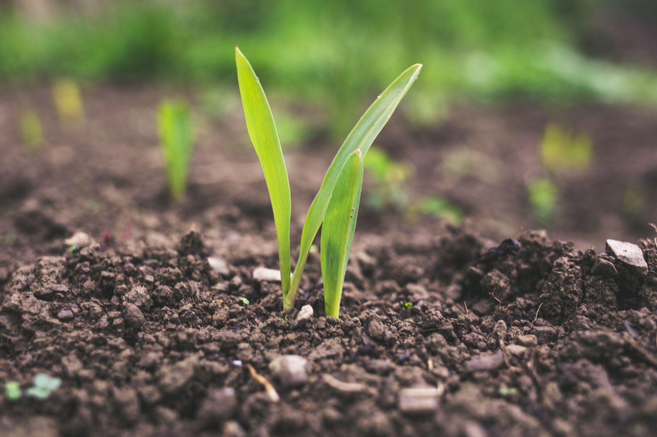
Scope
﻿This project has the potential to assist a farming enthusiast or an occupational farmer to make smarter decisions on his harvest strategy
It can provide necessary guidance related to cultivation and fertilizer ideas and curing crop diseases

Slide 9
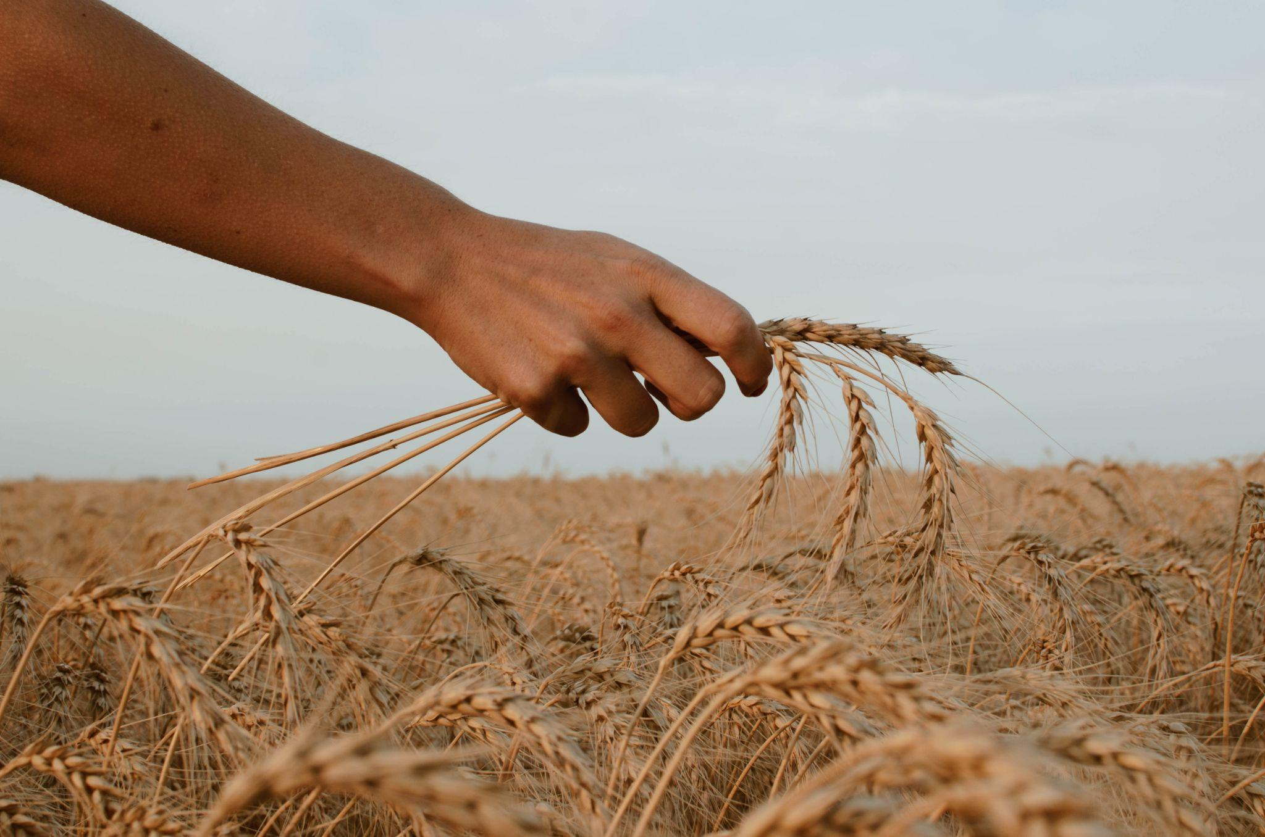
Limitation of Existing system
After the study of all the aforementioned works, we found 3 key limitations:
1) Absence of a unified product/service to solve problem
2) Products/services demanding a high computer literacy rate to be used by farmers
3) Lack of solution based approach in products/services with a classification or an identification system

Slide 10
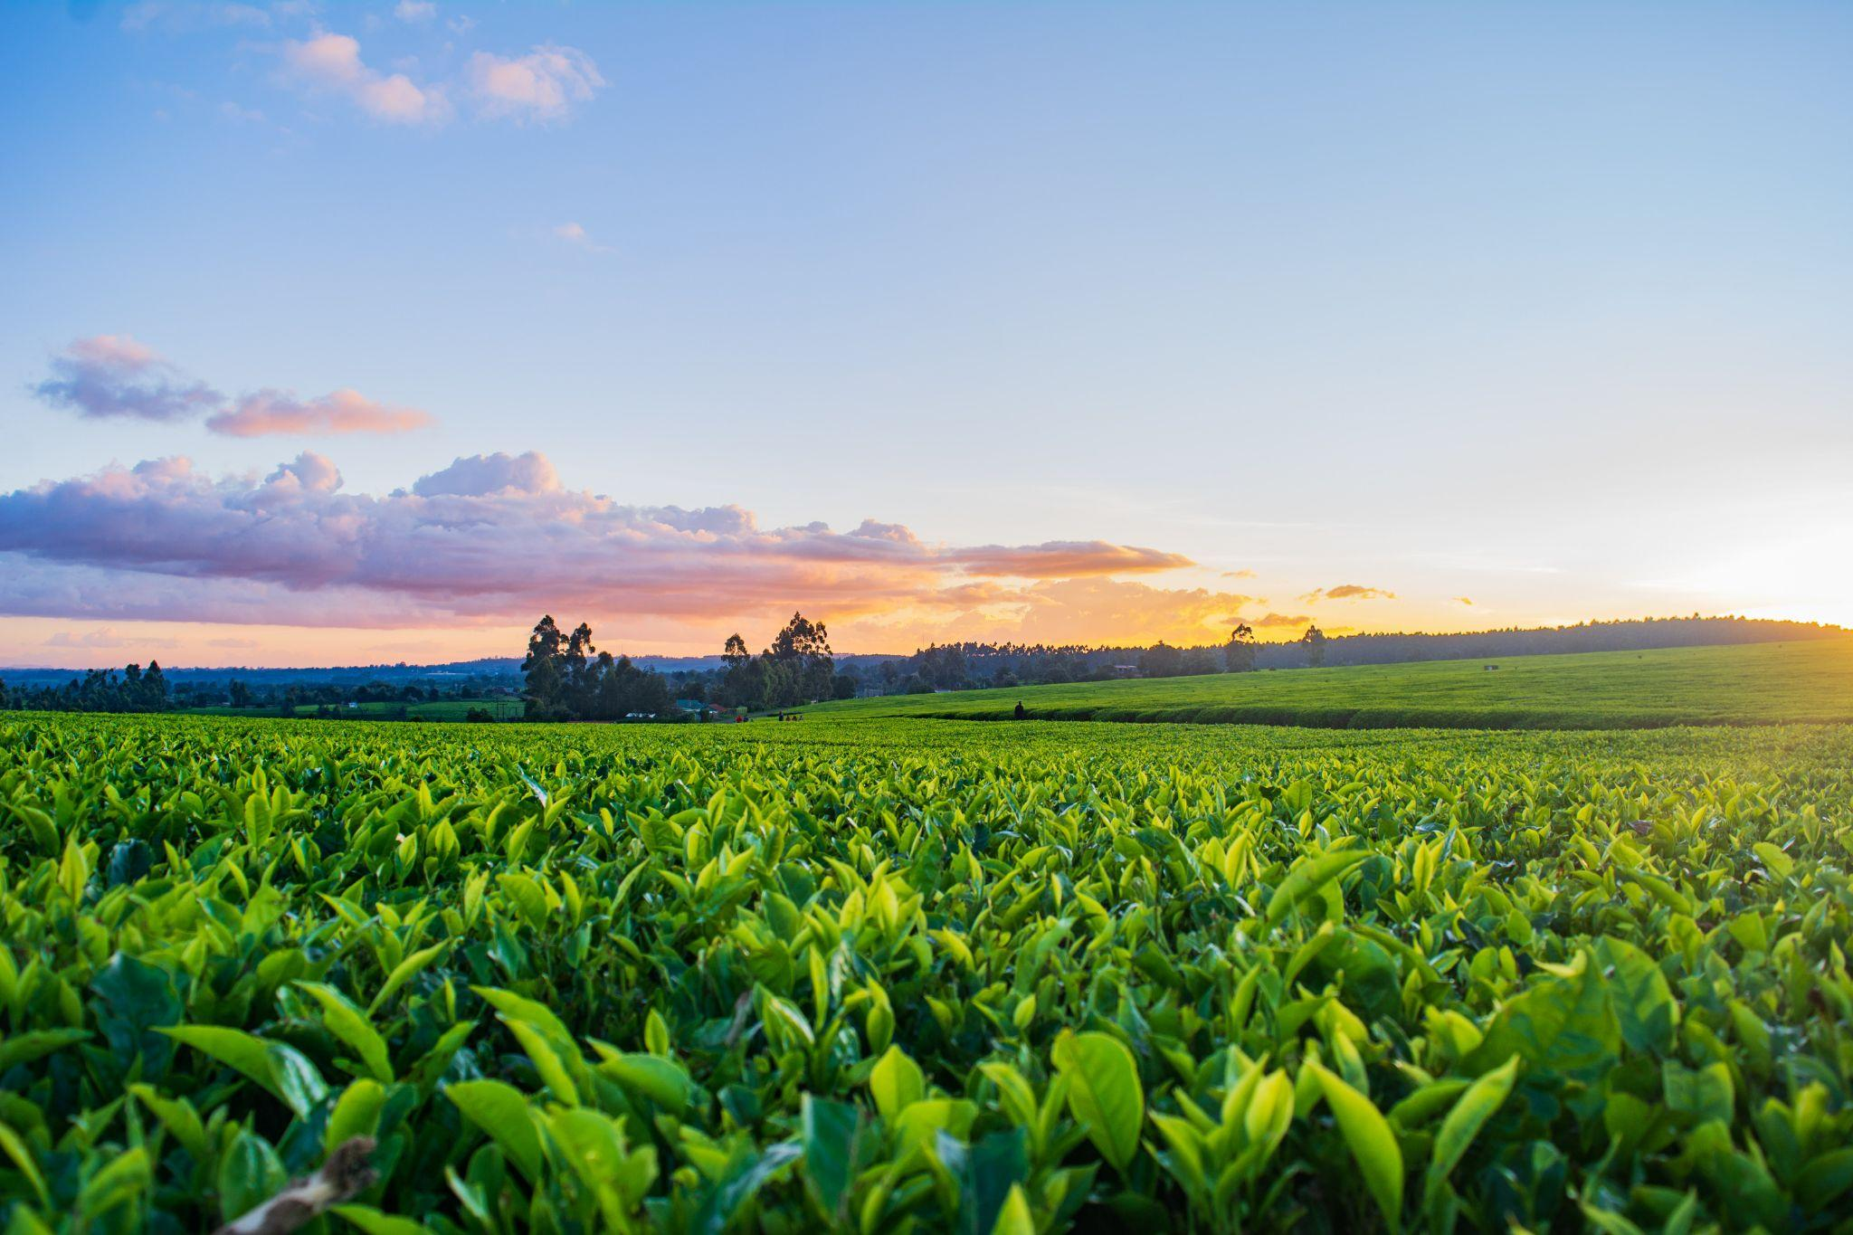
Technology Stack
Python 3.6 or higher
Numpy
Pandas
Scikit
Matplotlib
PyTorch
Flask

Slide 11
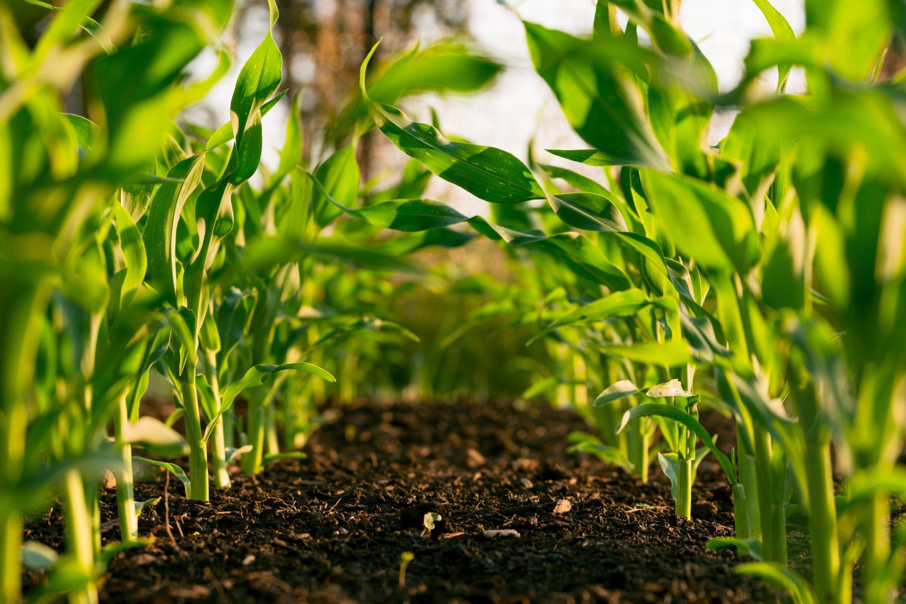
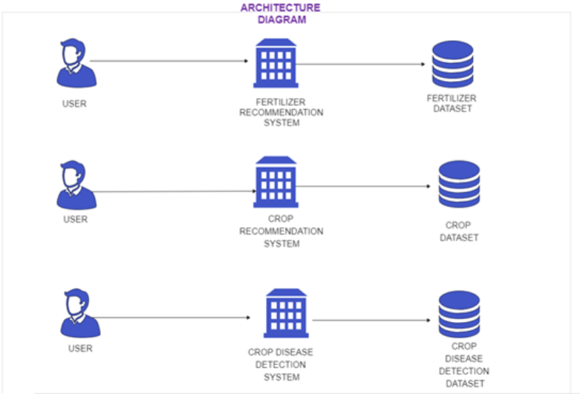
ARCHITECTURE DIAGRAM

Slide 12
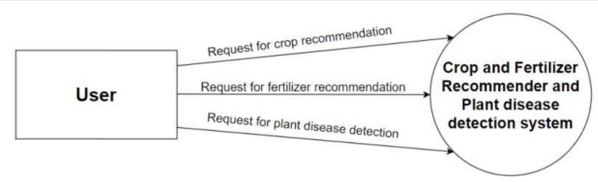
DFD LEVEL 0

Slide 13
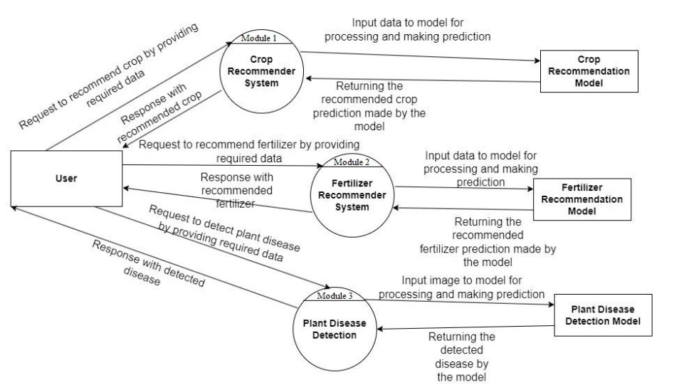
DFD LEVEL 1

Slide 14
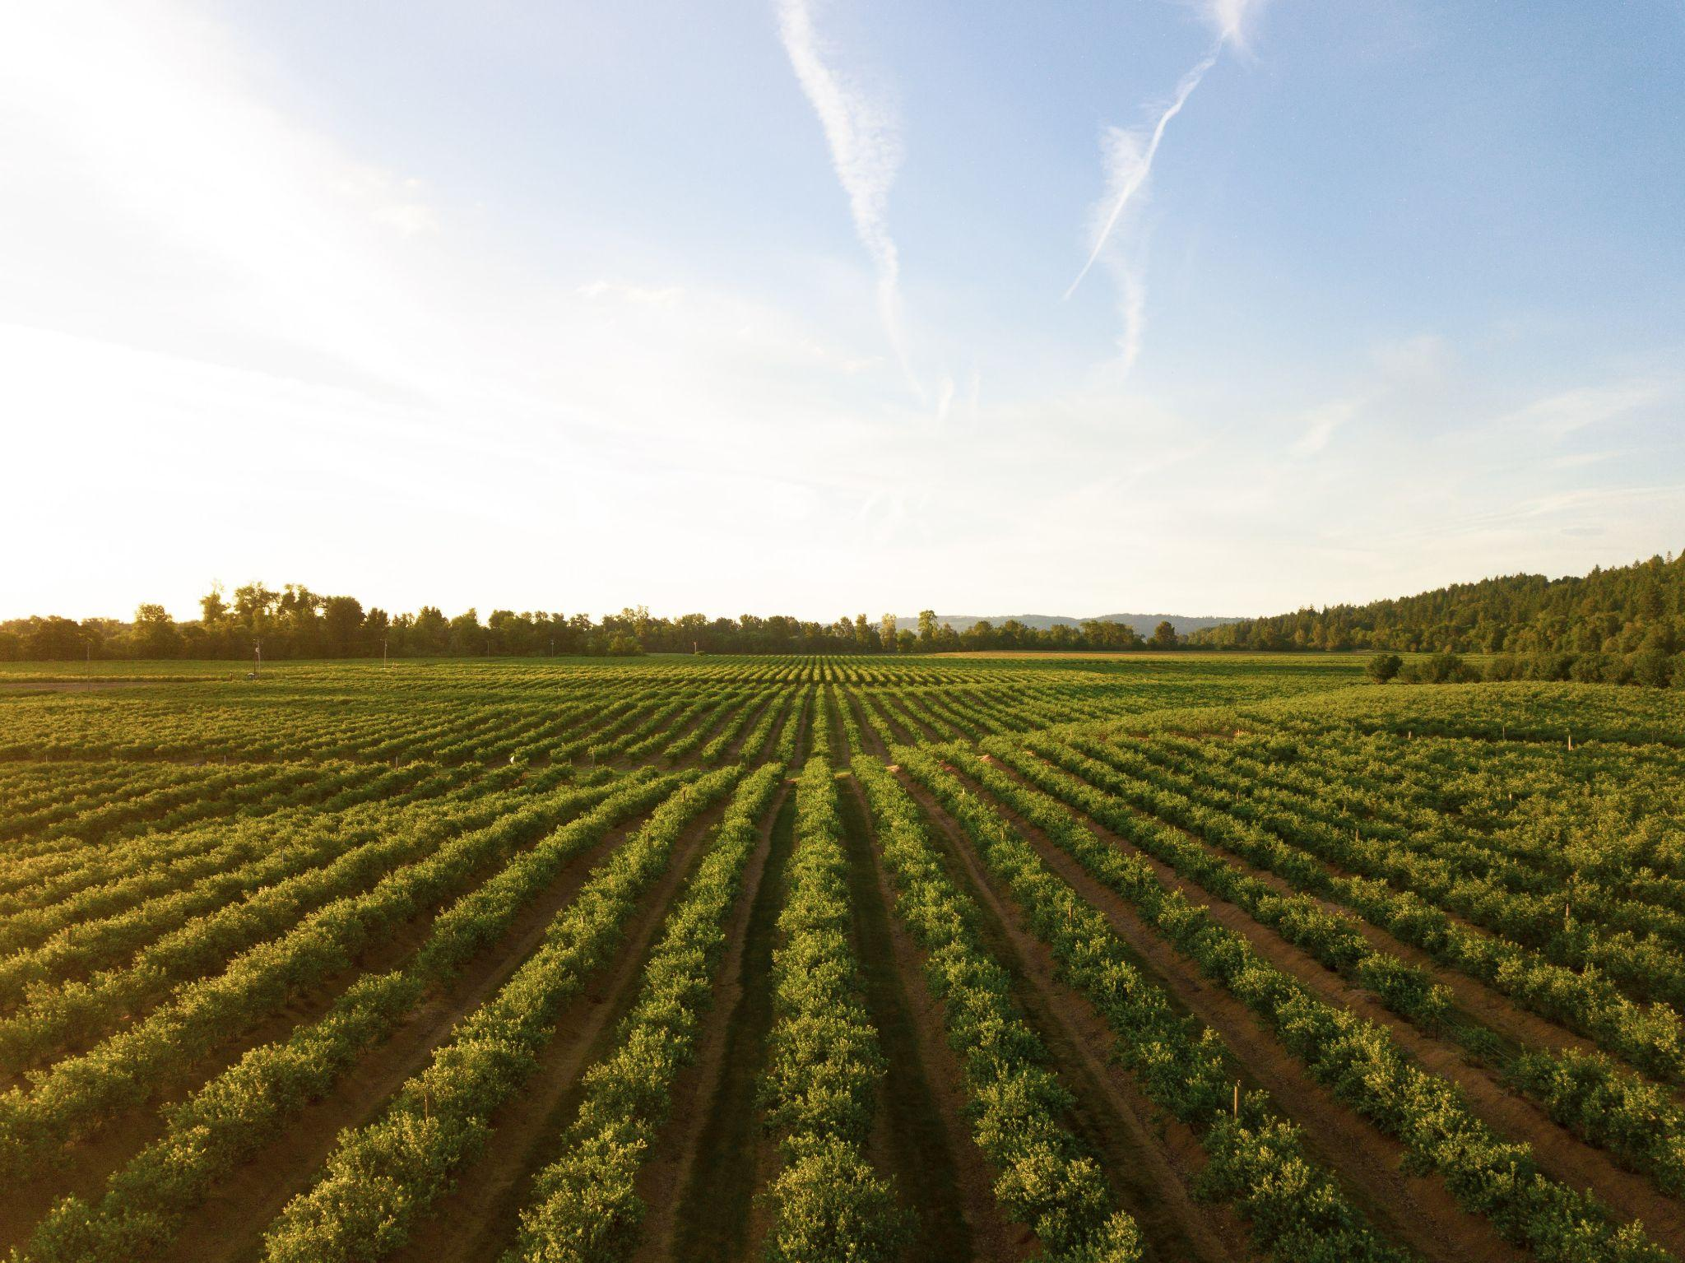
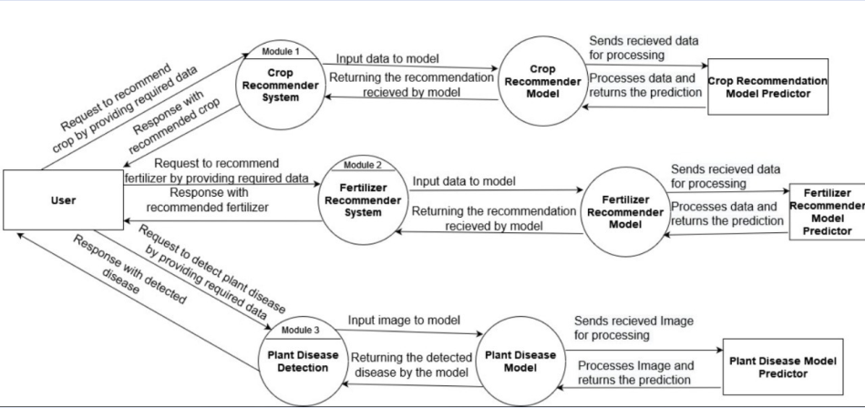
DFD LEVEL 2

Slide 15
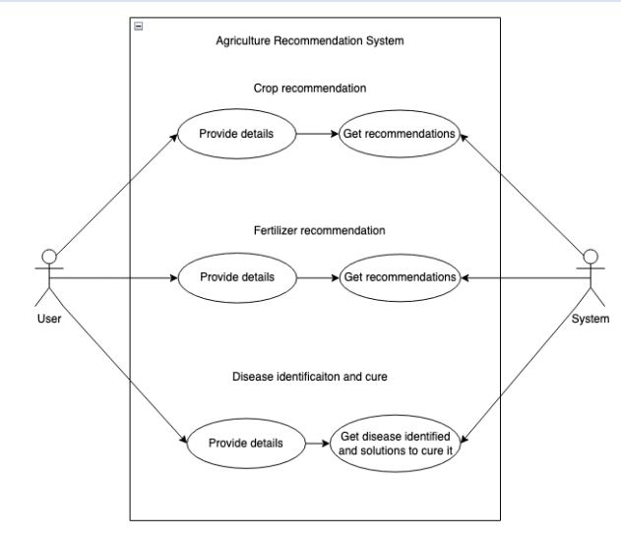
USE CASE DIAGRAM

Slide 16
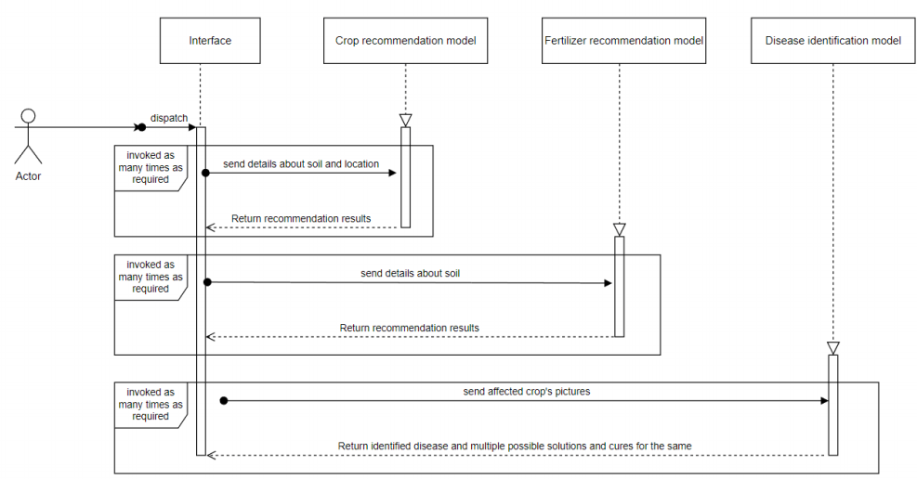
SEQUENCE DIAGRAM

Slide 17
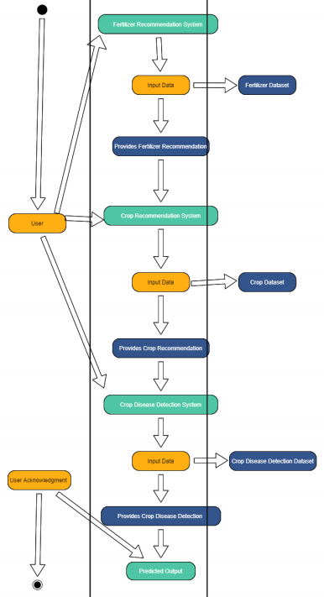
ACTIVITY DIAGRAM

Slide 18
Expected Outcome
Crop recommendation system: Should be able to predict the favourable crops according to soil and weather conditions within an acceptable accuracy range
Fertilizer recommendation system: Should be able to predict the favourable fertilizers according to soil conditions within an acceptable accuracy range
Crop Disease Classification system: Should be able to classify different crop disease using a photo and provide solutions for the same.
In addition to this, all these features would be in unified using a website which has a simple UI for naïve users.

Slide 19
Thank you !

